Slide 1
MESS MANAGEMENT SYSTEM
PREPARED BY:-
Lalit Kumar(2016ucp1572)
Narender Singh Yadav(2016ucp1474)
Bharat Pal Meena(2016ucp1650)

Slide 2
Introduction
The purpose of this application is to automatize the hostel functionality and provide both the user and admin a smart platform to interact with each other.
To use this facility the user has to login and with the account credentials he can login the account and get connected to the network.
Once connected the user can use the functionalities of mess such as accessing his account information, can check mess balance, can see history, can generate daily food coupon ,give feedback and checking the menu.

Slide 3
On the other the admin can log on and check the inventery details such as he can add new student and his balance,update mess menu,can announce information regarding mess and get to know the number of students visiting the mess that day.
This application aims at providing ease to both the user and admin.

Slide 4
overview
The Mess Management System helps the user to access all the functionalities of the mess without having to visit the mess physically. It enables the admin to view the inventory and access student details. This application is free of cost for the users. Individuals who wish to use any functionality of the mess can simply log in to the app and have everything on their fingertips. It uses the internet to update all user queries and put it across to the admin. Using the information provided by all the users the admin can take decisions and the inventory for the mess can be managed.

Slide 5
Functionality
Two users of mess management system.
1. Admin
2. Student

Slide 6
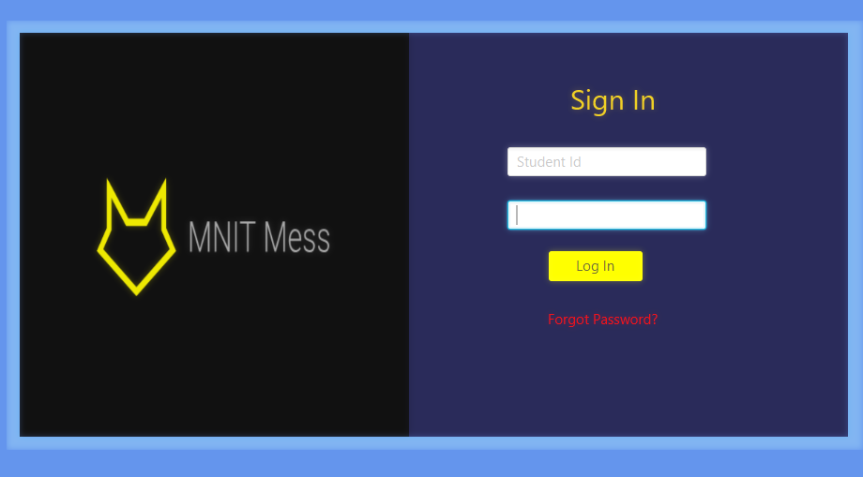
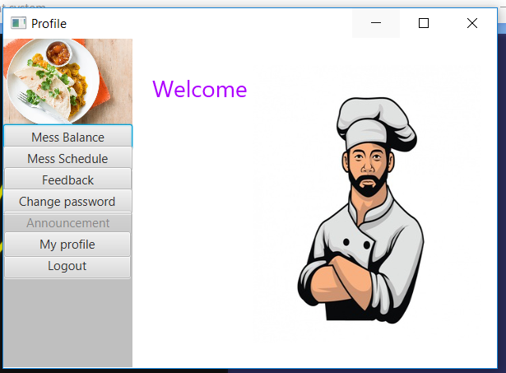
Admin
Functionality of admin :
1. Login : For admin change password and myprofile button will be disabled.

Slide 7
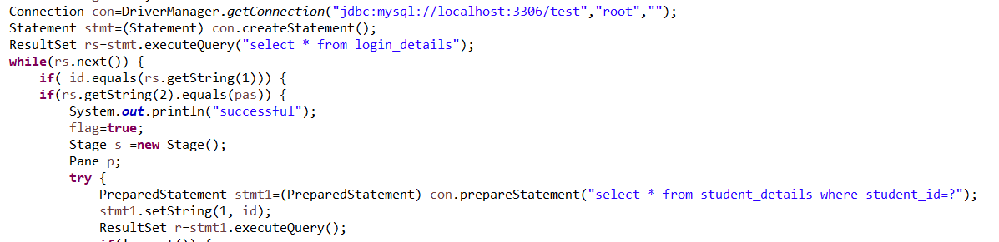
Sql query

Slide 8
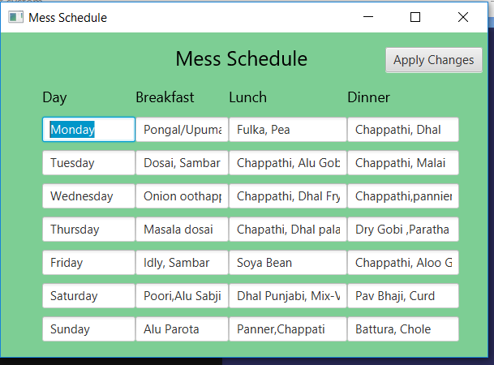
2. Update mess menu : admin can update mess menu.

Slide 9
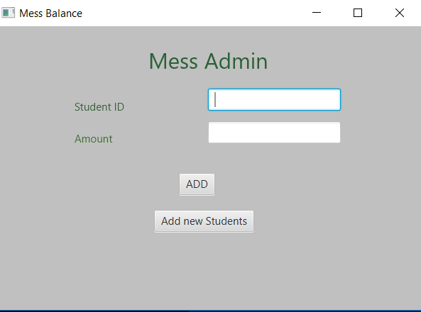
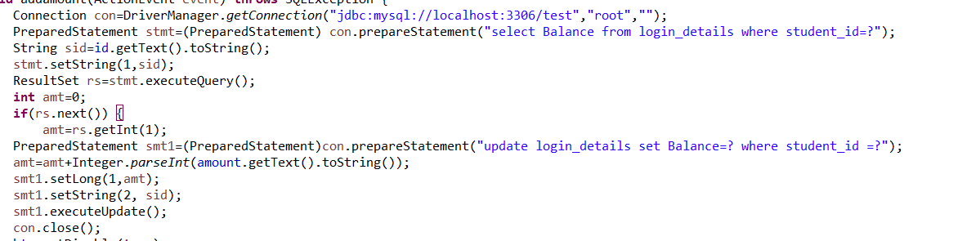
Add balance
Admin can add balance to any student account.

Slide 10
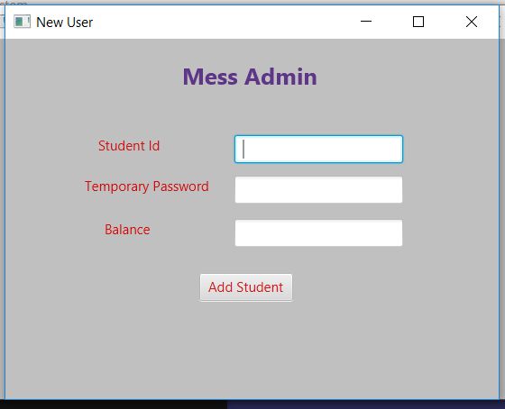
3.Add Students
Admin can new Students

Slide 11
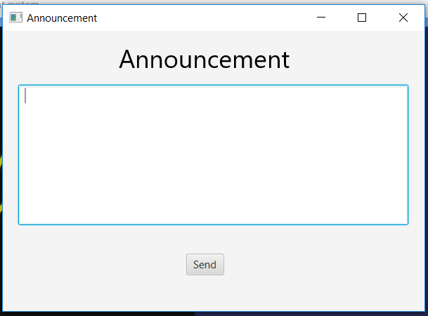
3.Announcement

Slide 12
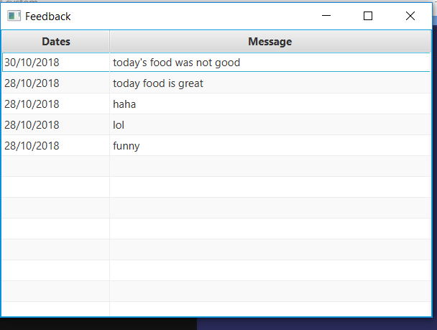
4.Feedback:
Can see feedback given by students in descending order by date

Slide 13
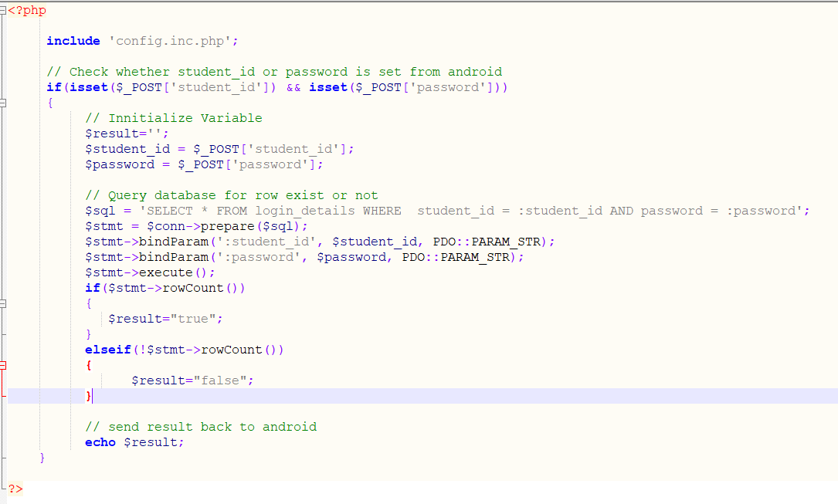
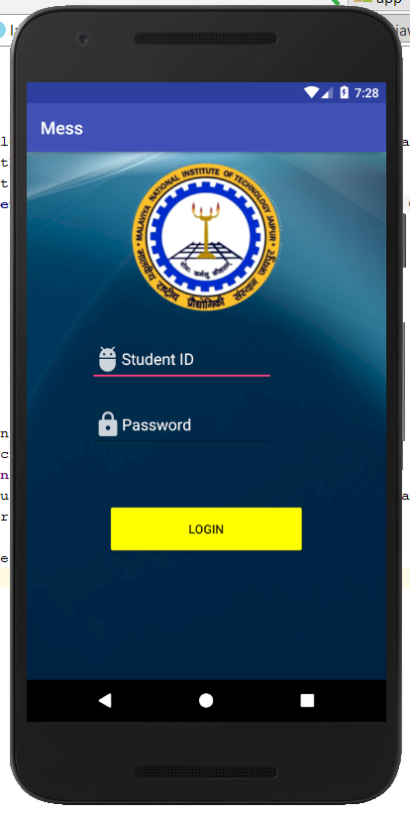
Student :

Slide 14
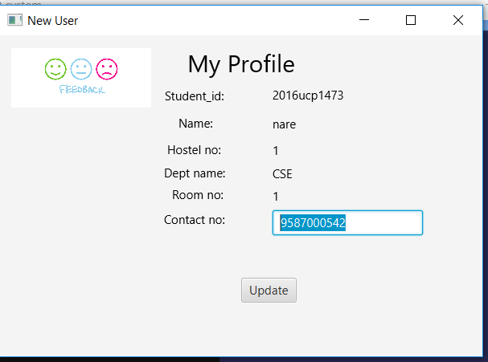
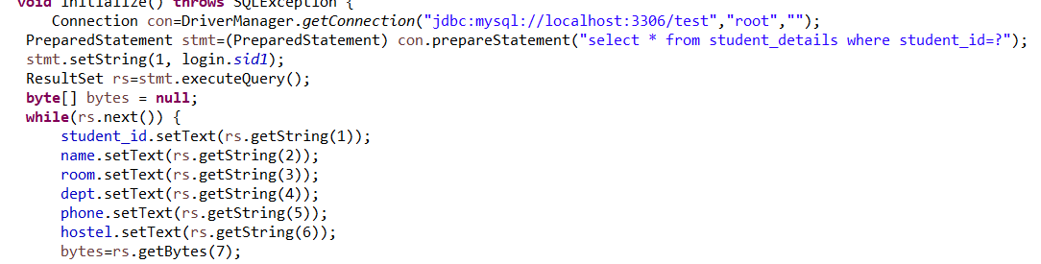
Student :
1. Profile :
Contact number is only editable

Slide 15
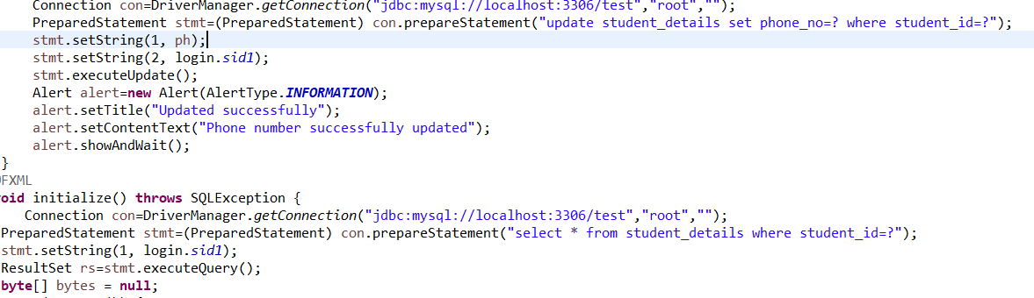
Update phone number

Slide 16
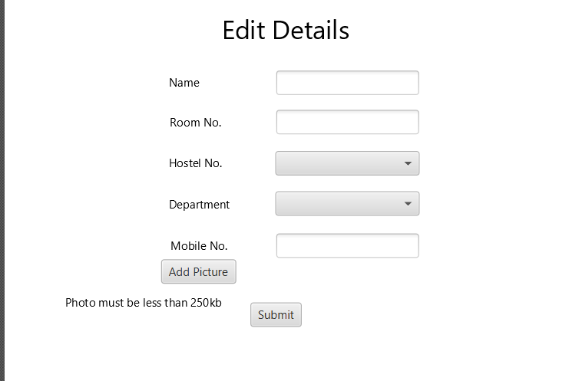
First Time Login
If doing first time login then he has to edit details

Slide 17
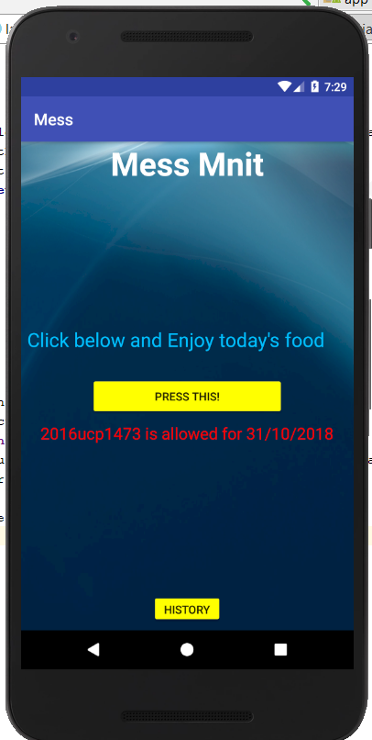
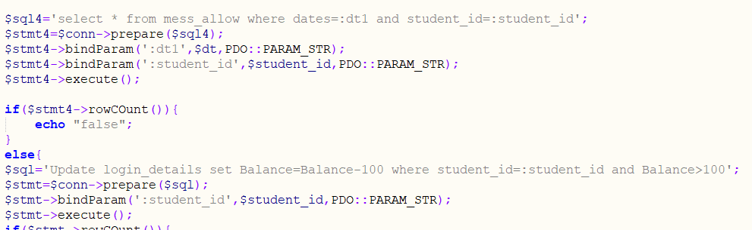
2.Can see generate food coupon: student can generate food coupon for today’s food.
Show date for which student is allowed
Single click is allowed for one day
Can check food history

Slide 18
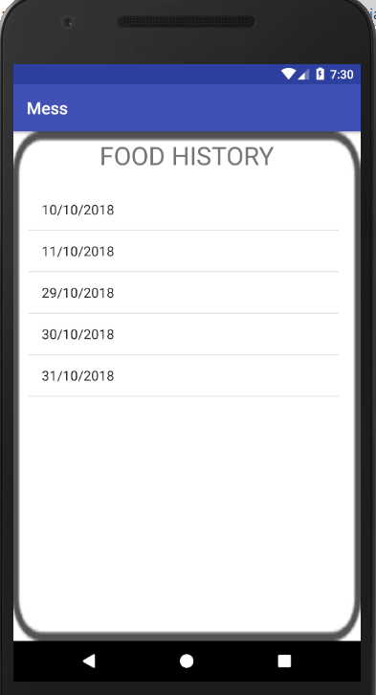
History :

Slide 19
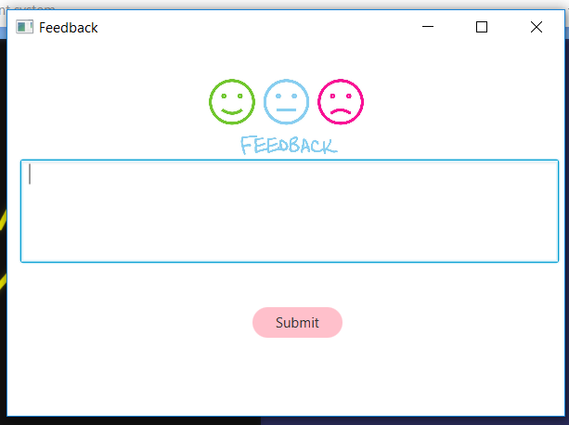
Feedback
Can give feedback and receive email

Slide 20
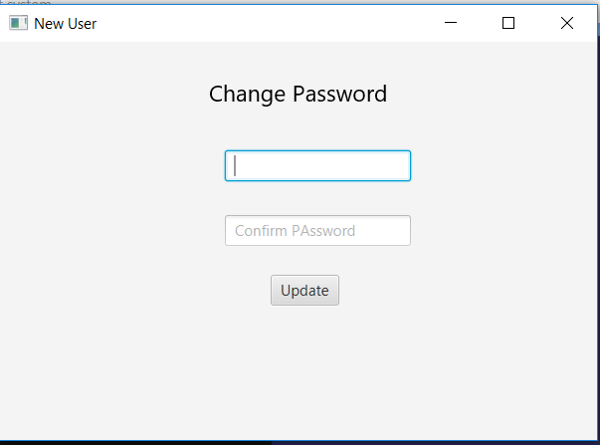
Change Password

Slide 21
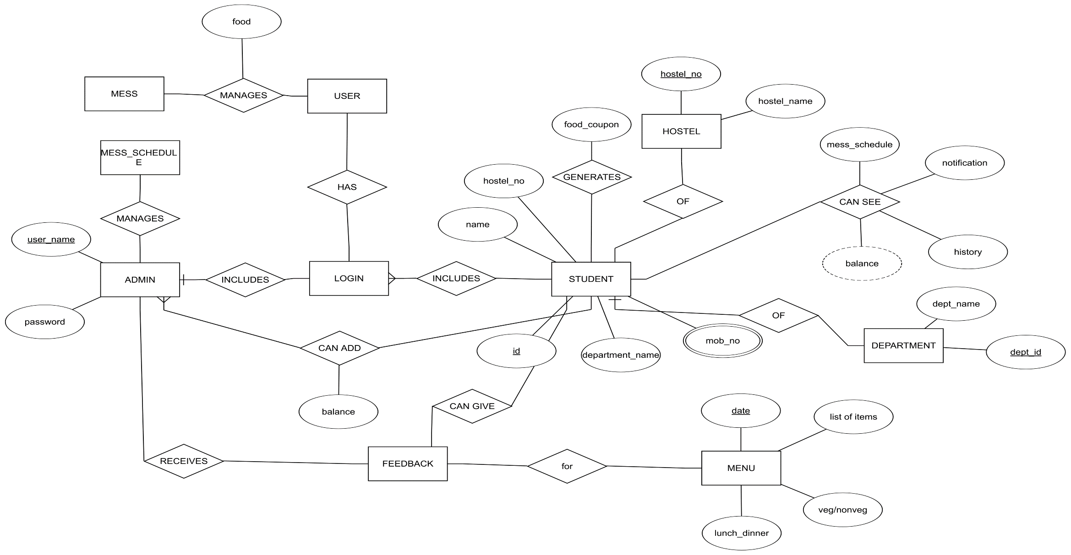
ER DIAGRAM

Slide 22
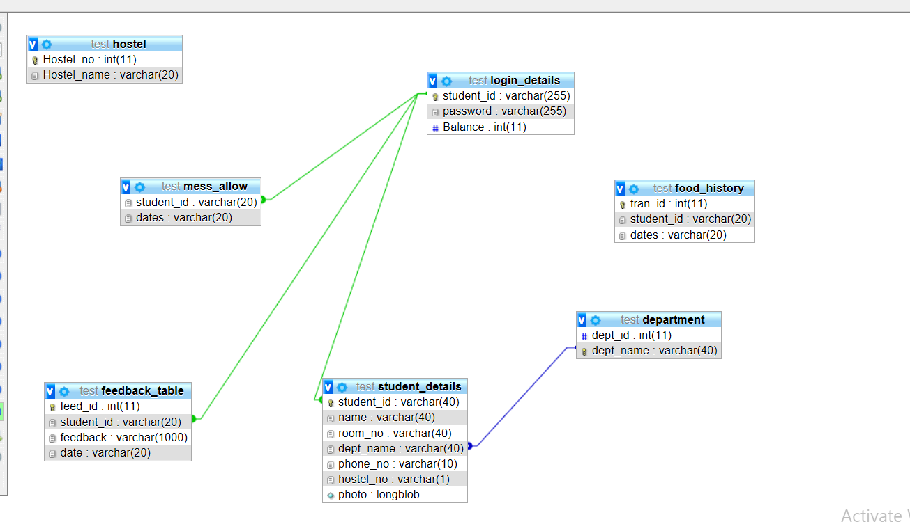
Relational schema

